Slide 1

Boba in Santa Clara

Slide 2
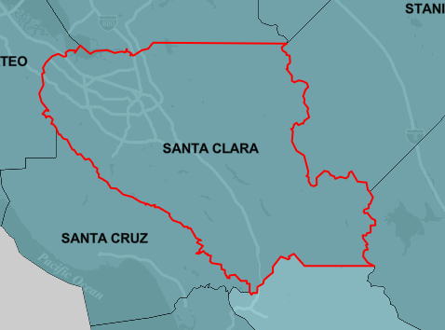
Santa Clara
Population 2019: 1.9 million

Slide 3

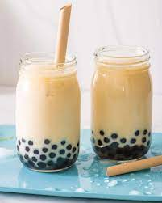
There are currently many boba shops in Santa Clara
Why?

Slide 4
Data cleaning
Gather census data from 2010
Gather venue data from Foursquare API
  All venues in Santa Clara
  Boba shops in Santa Clara
Determine population density
Determine the most popular boba shops

Slide 5
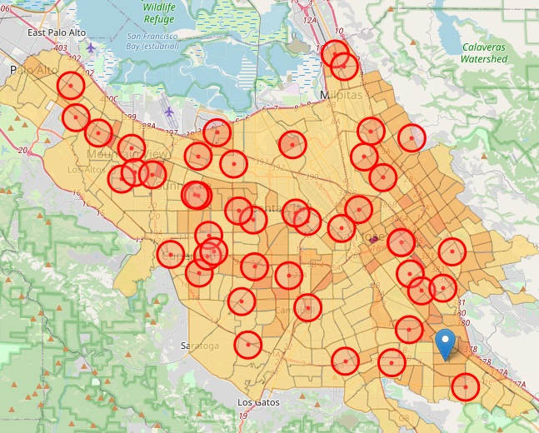
Population density

Slide 6
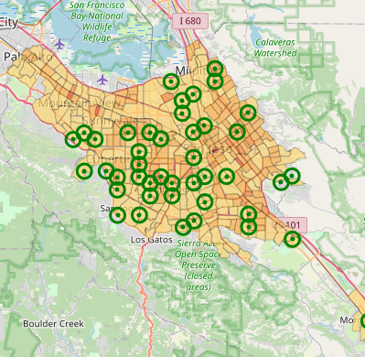
High population density and near other attractive venues

Slide 7
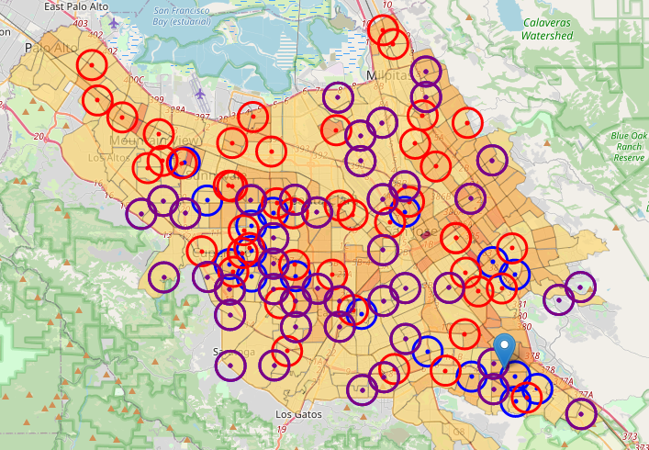
All data
Red- high population density
Purple- high density and near other attractive venues
Blue- potential places to open a boba shop

Slide 8

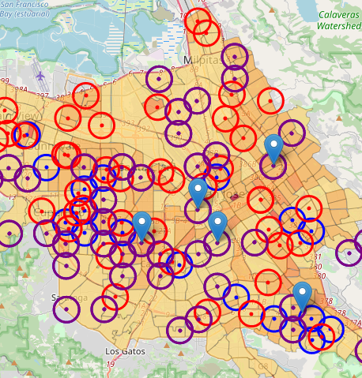
Conclusions:
Open up shop
I chose to focus on the potential places to open a boba shop that are farther away from existing boba shops
Marked with a blue pinpoint

Slide 9

Future work
Use the future shop locations and determine relation to freeways, parking accessibility and handicap accessibility.

